Slide 1
T-508 (ESTB) Tests of Shaslyk Calorimeter Modules from HERA-B
Dr. Edward Brash
Christopher Newport University and Jefferson Lab

Slide 2
T-508 Team
Dr. Carlos Ayerbe-Gayoso
Post-doc at W&M
Matt Burton
Grad student at W&M
Anthony Losada
Grad student at CNU
Jordan Thomas
Under grad at CNU
EJB

Slide 3
Purpose
The aim of these tests is to measure the position and energy resolution of a number of “Shaslyk” lead-scintillator sandwich type calorimeters which we have on loan from DESY. These modules were used in the HERA-B calorimeter.
We are evaluating these modules to ascertain if they are adequate for use in an upcoming experiment at Jefferson Lab.

Slide 4
Reasons for Testing
The energy resolution of these modules has been measured before, however, it is unclear how much radiation damage has affected the published performance characteristics.
The Jefferson Lab experiment involves electrons incident on the detector at a relatively wide range of angles, and thus we need to measure the position resolution for this angular range (no previous data which tells us this).
We will compare the data from these tests with our detailed simulations. This will help us to optimize our shower reconstruction algorithms, and thus optimize the position resolution.
This is our first experience using this type of calorimeter, and we wish to gain experience with its performance and operation.

Slide 5
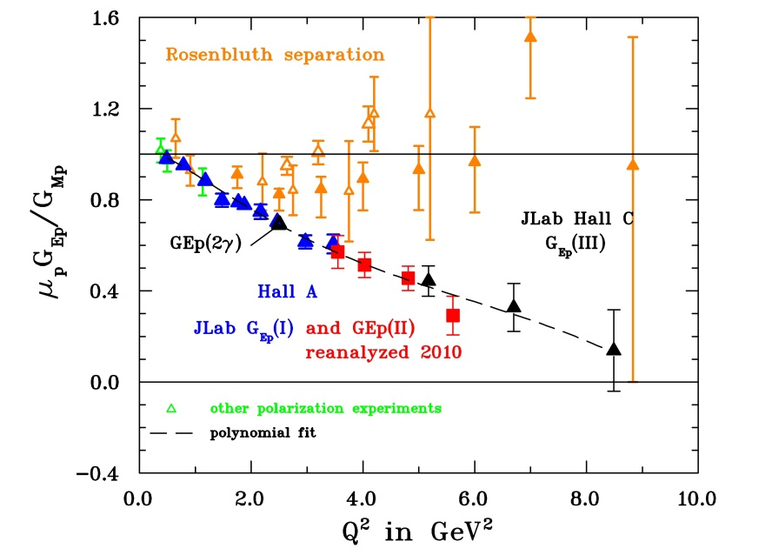
Gep(5) at JLab
This experiment at JLab is approved to measure the ratio of the proton elastic EM form factors up to a Q² of 15 GeV²

Slide 6
Gep(5) at JLab
Use recoil polarization technique – measuring the polarization components of the scattered proton in elastic e-p scattering (using a proton polarimeter).
Identifying elastic scattering events (rare at 15 GeV²) is key – must detect electron and proton in coincidence, and measure the energy and angle of the scattered electron with high precision.
High rate environment at JLab requires a new radiation-resistant electron calorimeter to be constructed for this.

Slide 7
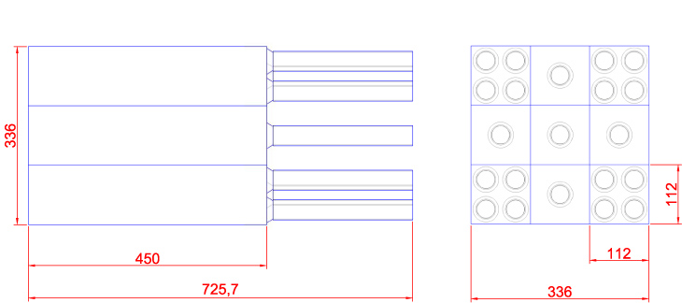
Arrangement of Calorimeter Modules

Slide 8
Test Plan
Begin with beam centered on central module – record about 10000 events per setting (approx. 1 hour assuming 3 Hz effective rate )
Move calorimeter (using x-y moveable table) to adjust beam position for a total of five positions on the module.
Repeat for each of the five single phototube modules
Repeat all of the above with the entire calorimeter rotated by 18 degrees wrt beam
Repeat at two or possibly three beam energies (low/med/high)
5 positions x 5 modules x 3 beam energies = 75 beam hours = 5 days assuming two 8-hour shifts per day.
Extra data:
Restack modules to measure other modules in the central position
Test four-phototube modules

Slide 9
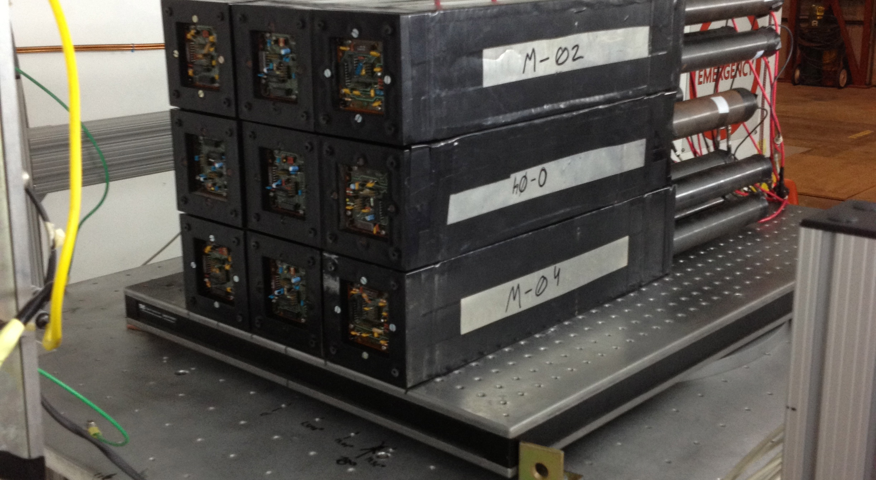
Current Status

Slide 10
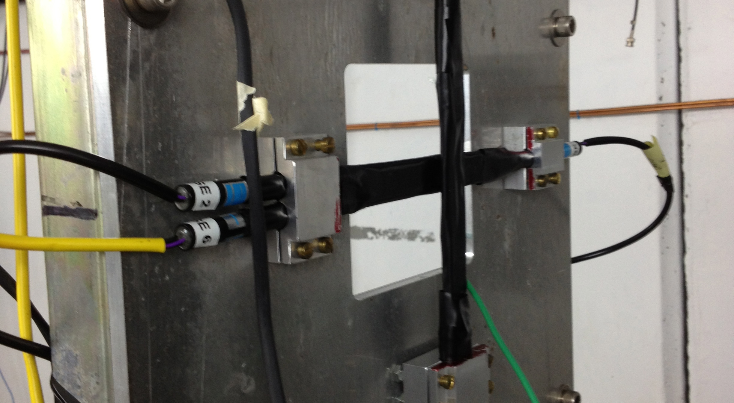
Current Status

Slide 11
Current Status
All hardware is installed/mounted, and cabled to front end electronics.
DAQ is fully configured and functioning.
Minor issue with HV crate that should be solved soon.
We should be ready for beam tomorrow morning!
Thank you to all of the SLAC staff who have helped us get set up so quickly.

Slide 12
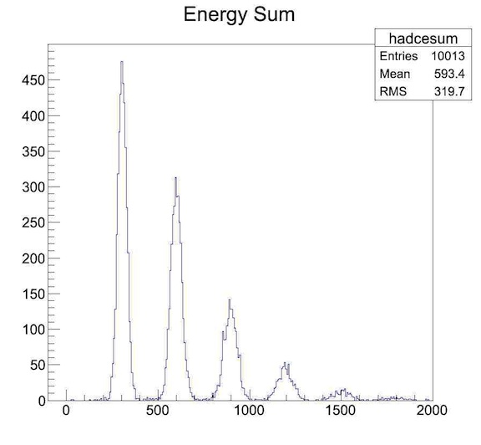
3 GeV Beam

Slide 13
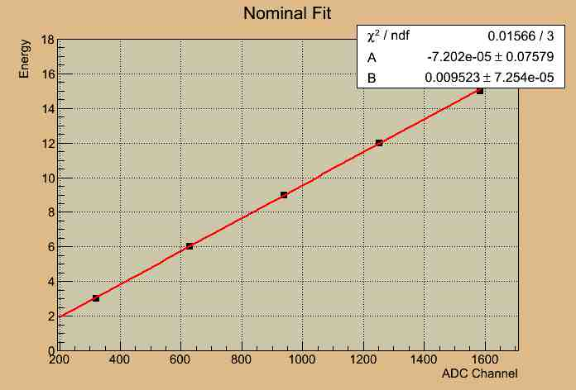
3 GeV Beam

Slide 14
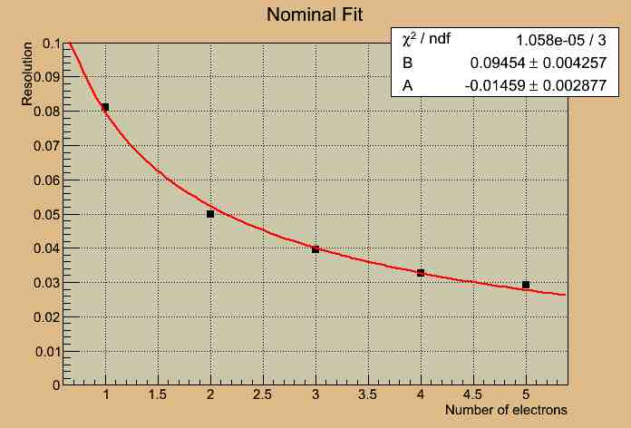
3 GeV Beam

Slide 15
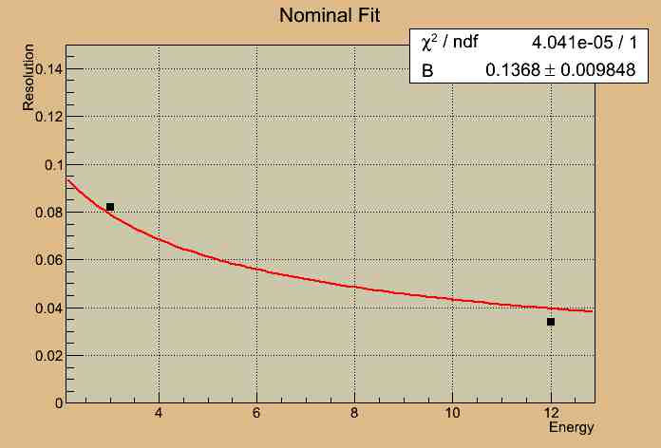
3 GeV Beam

